Slide 1

Bapuji Educational Association ®
BAPUJI INSTITUTE OF ENGINEERING AND TECHNOLOGY DAVANGERE,
KARNATAKA- 577004
DEPARTMENT OF ELECTRONICS AND COMMUNICATION ENGINEERING
Project Presentation
On
SMART VEHICLE IGNITION SYSTEM
PROJECT ASSOCIATES
BHAGYA D B 4BD21EC016
RANI C O 4BD21EC078
SINDHU B S 4BD21EC100
SRUSHTI S G 4BD21EC106
Dr. PRAKASH K.M
Dr. G. S. SUNITHA
MTech., Ph.D, MISTE, MIETE, MIE
MTech. (DEAC), Ph.D., MISTE, FIETE,FIE
PROJECT GUIDE
PROGRAM COORDINATOR

Slide 2
Vision of the Department
To be in the forefront in providing quality technical education and research in Electronics and Communication Engineering to produce skilled professionals to cater to the challenges of the society.
Mission of the Department
M1: To facilitate the students with profound technical knowledge through effective teaching learning process for a successful career.
M2: To impart quality education to strengthen students to meet the industry standards and face confidently the challenges in the programme.
M3: To develop the essence of innovation and research among students and faculty by providing infrastructure and a conducive environment.
M4: To inculcate the student community with ethical values, communication skills, leadership qualities, entrepreneurial skills and lifelong learning to meet the societal needs.

Slide 3
COURSE OBJECTIVES
This course will enable students to:
1. Prepare with foundation knowledge in a project domain through
designing, and implementing.
2. Introduce to various emerging fields in electronics and communication.
3. Provide an opportunity to exercise the creative and innovative qualities, to
become technopreneurs in group project environment.
4. Have hands-on experience in the related field so that students can
integrate and reinforce what has been taught in the classroom.

Slide 4
FLOW OF PRESENTATION
ABSTRACT
INTRODUCTION
LITERATURE SURVEY
PROBLEM IDENTIFICATION
OBJECTIVES
METHODOLOGY i) BLOCK DIAGRAM ii) FLOWCHART
COMPONENTS i)HARDWARE ii)SOFTWARE
RESULT
APPLICATIONS
ADVANTAGES
LIMITATIONS
FUTURE SCOPE
CONCLUSION
REFERENCES

Slide 5
ABSTRACT
This project proposes a Smart Vehicle Ignition System that integrates RFID, facial recognition, and fingerprint sensing to ensure secure vehicle access. Ignition is enabled only after successful multi-factor authentication. Post-ignition, alcohol detection ensures the driver's sobriety, and a tilt sensor monitors vehicle stability for accident prevention. If alcohol is detected or abnormal tilt occurs, the system triggers alerts and disables the engine. This enhances both vehicle security and driver safety, making it ideal for personal use and fleet management.

Slide 6
INTRODUCTION
In today's world, vehicle security and driver safety have become major concerns due to rising incidents of vehicle theft, unauthorized access, and drunk driving accidents.
The Smart Vehicle Ignition System is an innovative solution that enhances vehicle security and safety by integrating biometric authentication, RFID verification, alcohol detection, and IoT-based monitoring.
This system ensures that only authorized users can start the vehicle using fingerprint recognition and RFID authentication.
Additionally, it incorporates safety checks such as alcohol detection.
If any violation is detected, the system restricts ignition and sends alerts to the concerned authorities or vehicle owners.

Slide 7
LITERATURE SURVEY
S.No | Paper Title | Technology Used | Research Gap
1 | Design of Smart Vehicle Security System Using Finger Print Authentication with Integrated GSM and GPS Modules | Biometric (Fingerprint), GPS, GSM | Does not explore advanced anti-spoofing techniques or multifactor authentication beyond fingerprint.
2 | Driver identification system based on a machine learning operations platform using controller area network data | CAN Bus Data, ML Platform, Biometric Profiling | Focuses on pattern recognition; lacks real-time biometric integration such as iris or facial recognition.
3 | Comprehensive IoT-Based Vehicle Security: License Verification and Biometric Authentication | IoT, Fingerprint Scanner, Cloud | Limited to license and fingerprint; absence of fallback systems and no attack resilience benchmarking.
4 | DynamicLip: Shape-Independent Continuous Authentication via Lip Articulator Dynamics | Lip-motion Biometrics, AI, Continuous Authentication | Primarily conceptual and not yet adapted for embedded vehicular hardware or rugged environments.
5 | Navigating The Battleground: An Analysis Of Adversarial Threats And Protections In Deep Neural Networks | Deep Neural Networks, Biometric Protection, Adversarial AI | High-level analysis; lacks implementation specifics for biometric vehicle security in practice.

Slide 8
PROBLEM STATEMENT
Single-Factor Vulnerability: Many systems rely on a single point of authentication (e.g., key, basic key fob), which, if compromised (stolen, duplicated, hacked), grants full access to the vehicle.
Reactive Rather Than Proactive Safety: Most standard systems lack features to proactively prevent unsafe driving conditions (like drunk driving) or to automatically alert in case of an accident.
Limited Owner Awareness and Control: Owners often have minimal real-time information about their vehicle's status when they are away from it and lack immediate remote control options in case of theft or unauthorized use beyond a basic alarm sound.
No Intrinsic Driver Validation: Standard systems do not verify if the person attempting to operate the vehicle is indeed authorized or possesses a valid license for that specific context (though RFID here is a simplified proxy).
This project aims to directly address these identified problems by developing a multi-faceted system that is significantly harder to compromise, actively contributes to driver safety, and provides enhanced owner interaction and control.

Slide 9
OBJECTIVES
1. To design and implement a robust multi-level authentication system for vehicle ignition.
2. To integrate essential driver safety features like alcohol detection and accident detection.
3. To develop an IoT-based remote monitoring and control system using the ESP32's Wi-Fi capabilities and the Blynk platform.

Slide 10
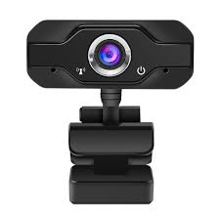
BLOCK DIAGRAM
Power supply
ESP32 MICRO CONTROLLER
LCD display
RFID Reader
Blynk server
Finger print sensor
Mobile Notification
Tilt sensor
Relay
Alcohol sensor
DC motor

Slide 11
METHODOLOGY
The project employs a layered, modular approach to achieve its objectives. The methodology involves distinct hardware and software components working in concert.
System Architecture Overview:
The system is architecturally divided into two main processing units:
Laptop (Face Recognition Unit): Handles the computationally intensive face recognition task using its built-in webcam and Python with OpenCV.
ESP32 Microcontroller (Main Control & IoT Unit): Manages all subsequent authentication layers (fingerprint, RFID), sensor inputs (alcohol, tilt), user interface (LCD), engine control (relay), and IoT communication (Blynk).
Communication between the laptop and ESP32 occurs via serial (USB) connection.

Slide 12
FLOWCHART
Start
Initialize camera, RFID, Finger print, alcohol, tilt sensor and display
Establish serial communication
Monitor and control following tasks repeatedly
Does face match?
Yes
Does RFID match?
Yes
Does Finger match?
Yes
No
No
No
Display on LCD
Send notification and turn on engine
Alcohol or accident detected?
Yes
Send notification and turn off engine
No
Stop

Slide 13
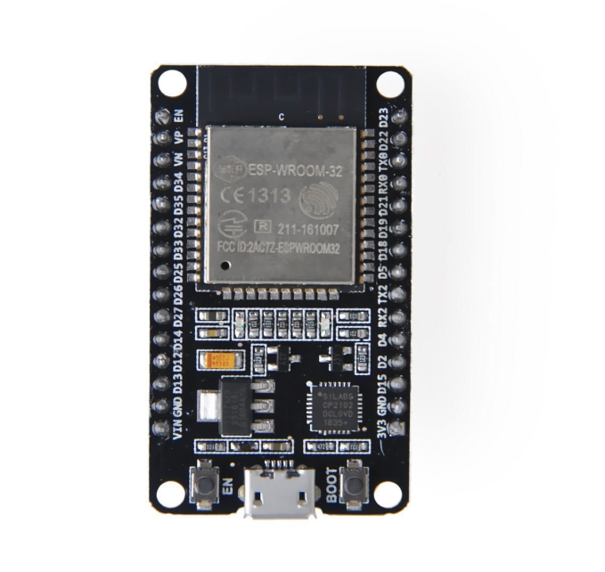
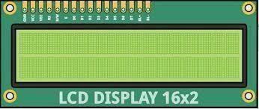
HARDWARE DESCRIPTION
1.ESP32 Development Board (e.g., ESP32-
WROOM-32 based):
This is a small computer with Wi-Fi and Bluetooth.
Use: It controls the whole system and connects to all the sensors. It decides whether to allow the vehicle to start or not.
2.LCD Display :
A simple screen to display messages.
Use: Shows system status messages like "Scan Finger","Access Granted","Alcohol Detected", etc., to the user.

Slide 14
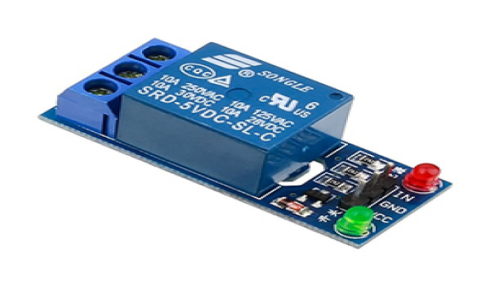
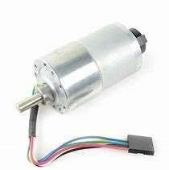
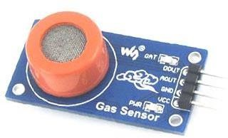
3.Relay :
An electrically controlled switch.
Use: Controls the connection to the vehicle's ignition system. The ESP 32 turns the relay ON/OFF to start or block the engine based on authentication.
4.DC Motor :
An electric motor that runs on direct current.
Use: Can be used to simulate engine operation or control doors/locks once authentication is successful.
5.Alcohol Sensor (MQ-3):
This sensor can detect alcohol in the driver's breath.
Use: If it senses alcohol, it stops the vehicle. This helps prevent drunk driving.

Slide 15
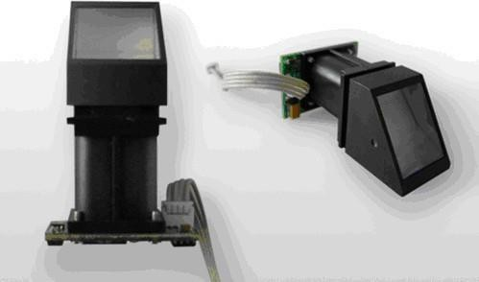

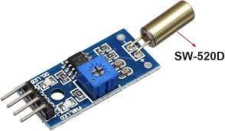
6.Fingerprint Reader:
A biometric scanner.
Use: Verifies the identity of the driver through their fingerprint.
Adds a second layer of authentication
before ignition.
7.Laptop with Built-in Webcam:
The webcam takes pictures of the driver.
Use: It is used to check if the right person is trying to start the vehicle. It helps with face recognition or driver monitoring.
8.Tilt Sensor (MPU6050 Gyro/Accelerometer):
This sensor can feel movement, shaking, or tilting.
Use: It helps detect accidents or if someone is trying to move the vehicle. It can be used to send alerts or stop the ignition.

Slide 16
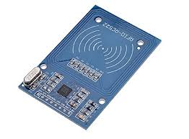
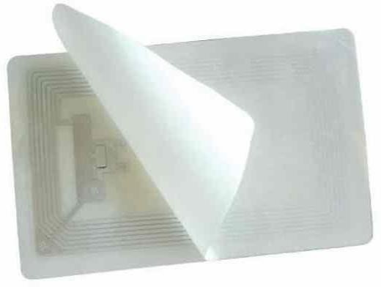
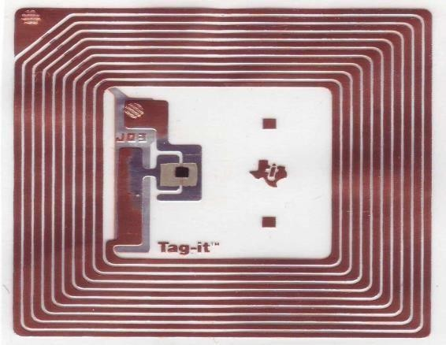
9.RFID Reader Module (MFRC522):
This reads the RFID card or tag.
Use: It checks if the person has permission to start the vehicle. If the card is valid, the system allows the ignition.
10.RFID Tag:
This is a card or key with a unique ID.
Use: It works like a key for the vehicle.
Only registered tags can start the vehicle.
11.Power Supply:
Appropriate power supply for ESP32, sensors, and DC motor (may require separate supplies or a robust single supply with voltage regulation).

Slide 17

SOFTWARE DESCRIPTION
1.ARDUINO IDE :
An open-source software used to write, compile, and upload code to ESP32 board. Supports programming in C/C++.
Used to write and upload the control logic (written in Embedded C) to the ESP32. It handles RFID scanning, fingerprint verification, sensor reading, and relay control.
2. EMBEDDED C :
A programming language used to program microcontrollers. It’s a variant of C designed for hardware-level access.
Core logic (like reading sensor values, comparing RFID IDs, matching fingerprints, and controlling the relay) is written in Embedded C and compiled/uploaded via Arduino IDE.

Slide 18

3.BLYNK PLATFORM:
An IoT platform used for creating a mobile application (dashboard) for remote monitoring and control.
Blynk App (iOS/Android): User interface on the smartphone with widgets like buttons, displays, notifications.
4.PYTHON :
A high-level, general-purpose programming language, known for its readability and wide library support.
Python can be used for external monitoring, data logging, or running machine learning algorithms (e.g., for behavior analysis). It can also interface with the fingerprint module or camera systems on a PC or Raspberry Pi.

Slide 19

4.OPEN CV :
An open-source computer vision library used for real-time image and video processing.
If the system include facial recognition, OpenCV (used with Python or C++) can process camera inputs to verify driver identity or alert unsafe conditions.
5. FACE DETECTION ALGORITHM (HAAR CASCADES - PYTHON, OPENCV):
Detects the presence and location of a face in front of the camera using predefined facial features like eyes and nose.
6. FACE RECOGNITION ALGORITHM (LBPH - LOCAL BINARY PATTERNS HISTOGRAMS – PYTHON, OPENCV):
Identifies if the detected face matches a stored authorized user by analyzing facial patterns.

Slide 20
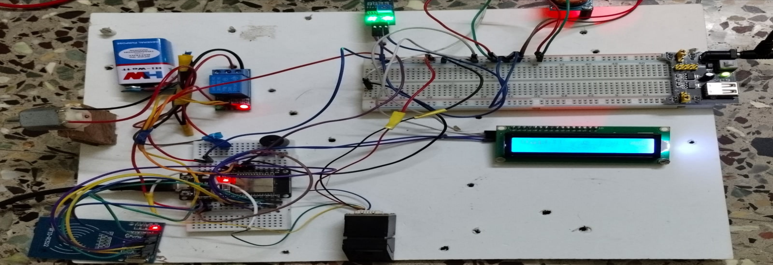
RESULTS
The smart vehicle ignition system successfully authenticates users using RFID, face recognition, and fingerprint verification.
The vehicle only starts when all three authentication steps are passed.
After ignition, the alcohol sensor detects driver sobriety and stops the motor if alcohol is found.
The tilt sensor monitors vehicle position and alerts in case of abnormal tilt or rollover.
The system enhances both vehicle security and driver safety effectively.

Slide 21
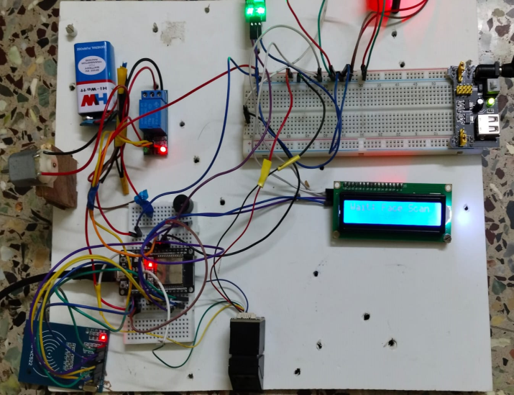
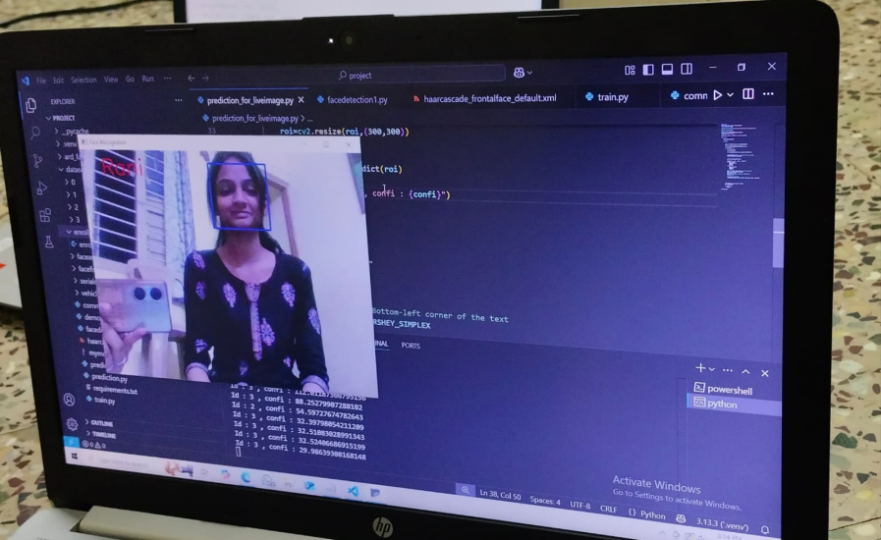
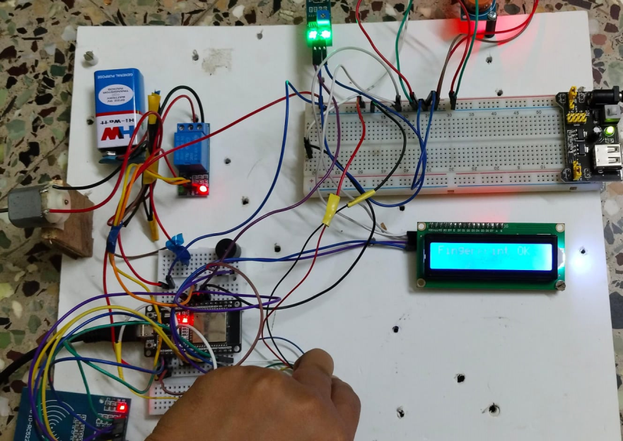
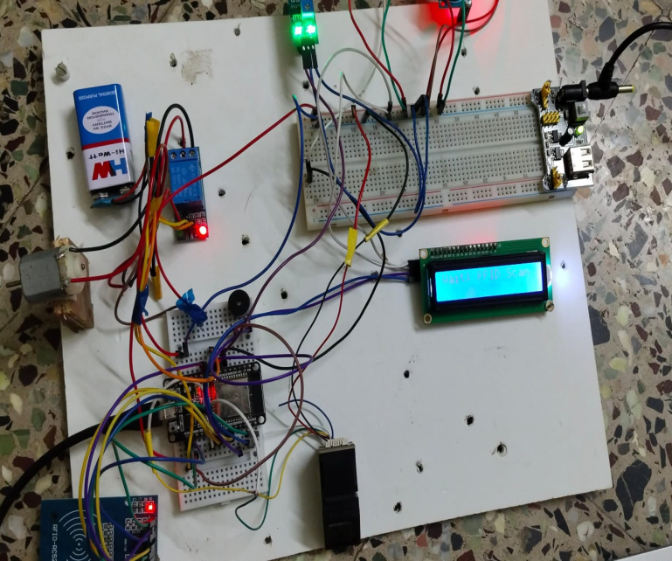
Fig : waiting for face authentication
Fig : waiting for RFID & Finger authentication

Slide 22
APPLICATIONS
Personal Vehicles: Enhancing the security of private cars, motorcycles, and trucks against theft and unauthorized use. Provides peace of mind to owners with remote monitoring.
Commercial Fleet Management: For companies with a fleet of vehicles (e.g., delivery services, taxi companies), this system can ensure that only authorized drivers operate specific vehicles, track usage (via notifications), and potentially reduce insurance premiums by demonstrating enhanced security. The alcohol detection feature is particularly valuable for commercial driver safety.
Rental Car Agencies: Can be adapted to ensure that only the registered renter can operate the vehicle and to monitor for misuse or potential accidents. RFID could be linked to rental agreements.
Heavy Machinery and Equipment: Securing expensive construction or agricultural machinery that is often left on site and vulnerable to theft or unauthorized operation.
Shared Mobility Services: Could be integrated into car-sharing or bike-sharing platforms to provide robust user authentication before vehicle use.

Slide 23
ADVANTAGES
Enhanced Security: Multi-layer authentication (face, fingerprint, RFID) makes it significantly more difficult for unauthorized individuals to bypass the system compared to single-factor methods.
Increased Driver Safety: Integration of alcohol detection helps prevent drunk driving. Accident detection (tilt sensor) can provide early alerts.
Remote Monitoring and Control: IoT integration via Blynk allows owners to receive real-time status updates (e.g., engine start) and remotely disable the engine in emergencies or suspected theft.
User Identification: Face and fingerprint recognition provide strong, unique identification of the authorized user.
Customizable and Scalable: The modular design allows for potential future additions or modifications of security layers or sensors.
Reduced Risk of Key-Related Issues: Mitigates risks associated with lost, stolen, or duplicated physical keys.

Slide 24
LIMITATIONS
1. Face Recognition Challenges: Performance can be affected by extreme lighting conditions (very dark or direct sunlight), significant changes in user appearance (e.g., masks, heavy makeup, different hairstyles not in training), or if the camera is obscured.
2. Fingerprint Sensor Issues: Can be unreliable with wet, dirty, or scarred fingers. Quality of the sensor affects performance.
3. Tilt Sensor Simplicity: A basic tilt sensor (like SW-520D) might trigger false alarms on steep inclines or very bumpy roads if not calibrated carefully. It cannot distinguish types of impacts.
4. Power Consumption: The ESP32 (especially with Wi-Fi active) and various sensors can consume considerable power, which might be a concern for long-term battery operation in a real vehicle if not connected to the vehicle's main power supply with proper management.
5. Complexity: The system involves multiple hardware and software components, increasing complexity in terms of development, troubleshooting, and cost.

Slide 25
FUTURE SCOPE
1. Embedded Face Recognition: Replace the laptop-based face recognition with an embedded solution using a more powerful microcontroller (like ESP32-CAM with limitations, or a Raspberry Pi, Jetson Nano) directly integrated into the vehicle for a standalone system.
2. GPS Integration: Add a GPS module for real-time vehicle tracking, which can be reported via Blynk or SMS in case of theft or accident.
3. Multi-User Management: Develop a more sophisticated system for managing multiple authorized users with different permission levels, easily configurable by the primary owner.
4. Power Optimization: Implement power-saving modes and optimize code for reduced energy consumption, especially if intended for battery-powered standalone operation.

Slide 26
CONCLUSION
This project successfully demonstrated the design and implementation of a "Multi-Level Security System for Vehicles" incorporating face recognition, fingerprint scanning, RFID validation, alcohol detection, accident sensing, and IoT-based remote monitoring and control. The system effectively integrates Python for face recognition on a laptop with an ESP32 microcontroller managing subsequent security layers, sensors, and user interaction via an LCD and the Blynk platform. The layered authentication approach significantly enhances vehicle security compared to traditional systems. The inclusion of safety features like alcohol and accident detection contributes positively to driver and vehicle safety. The IoT capabilities provide valuable real-time awareness and control to the vehicle owner.
The project successfully met its core objectives by creating a functional system that validates users through multiple checks before granting access and allowing engine operation.

Slide 27
REFERENCES
[1] S. Ahmed and M. K. Hasan, "Face Recognition Based Car Ignition System with Anti-Theft Security using GSM Technology," International Journal of Computer Applications, vol. 167, no. 8, pp. 12-16, Jun. 2017. DOI: 10.5120/ijca2017914404.
[2] P. Kumar and R. Singh, "A Multi-Layered Vehicle Security System using Fingerprint and RFID Technology," in Proceedings of the 3rd International Conference on Computing Methodologies and Communication (ICCMC), Erode, India, Mar. 2019, pp. 865-869. DOI: 10.1109/ICCMC.2019.8819774.
[3] R. Patel, M. Shah, and R. Makwana, "IoT Based Smart Vehicle Alcohol Detection and Accident Alert System," International Journal of Engineering and Advanced Technology (IJEAT), vol. 9, no. 3, pp. 2345-2349, Feb. 2020. DOI: 10.35940/ijeat.C6239.029320.
[4] P. Viola and M. J. Jones, "Robust Real-Time Face Detection," International Journal of Computer Vision, vol. 57, no. 2, pp. 137-154, May 2004. DOI: 10.1023/B:VISI.0000013087.49260.fb.
[5] T. Ahonen, A. Hadid, and M. Pietikäinen, "Face Description with Local Binary Patterns: Application to Face Recognition," IEEE Transactions on Pattern Analysis and Machine Intelligence, vol. 28, no. 12, pp. 2037-2041, Dec. 2006. DOI: 10.1109/TPAMI.2006.244.

Slide 28
COURSE OUTCOMES
On completion of this course, students are able to:
1. Get exposed to literature available for research challenges in
interdisciplinary fields.
2. Get an insight of real world problems, challenges and related
engineering issues to broader societal context.
3. Implement their idea using modern tools & new technologies.
4. Demonstrate professionalism with ethics, individual & team management
and effective communication skills to comprehend & to write reports.

Slide 29
THANK YOU

